Slide 1

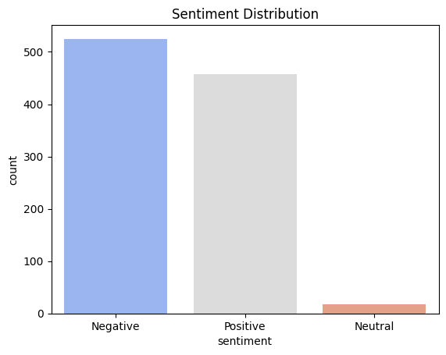
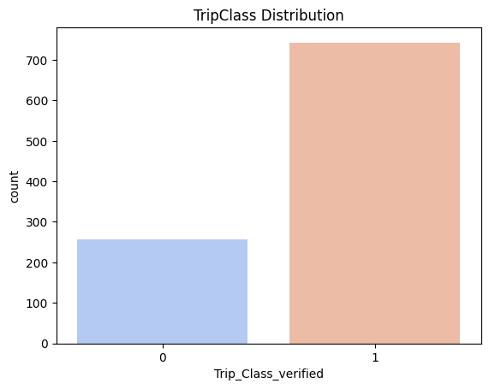
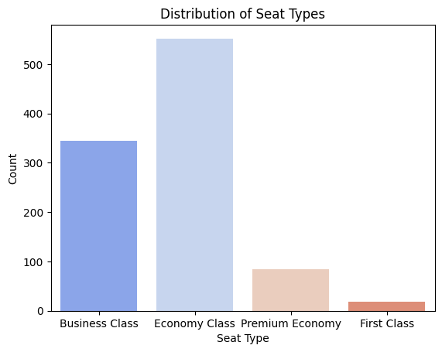
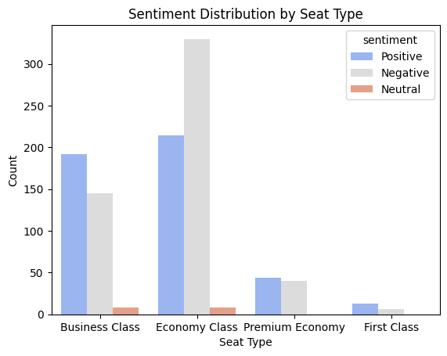
Task 1: Web scraping to gain company insights
Insights
If Trip Verified count is higher:
Most trips are verified, indicating strong authentication measures.
Passengers prefer or comply with trip verification.
A lower percentage of non-verified trips suggests minimal fraudulent activity.
If Trip Not Verified count is higher:
A significant portion of trips remain unverified, raising concerns about security and reliability.
Potential issues in the verification process (e.g., complexity, lack of awareness).
May indicate fraudulent bookings or non-compliance with verification protocols.
Insights:
Economy Class may need service improvements to address high negative sentiment.
Business Class maintains a strong reputation, but continuous quality assurance is recommended.
Premium Economy has growth potential if promoted effectively.
First Class has low engagement, possibly due to a niche customer base.

Slide 2
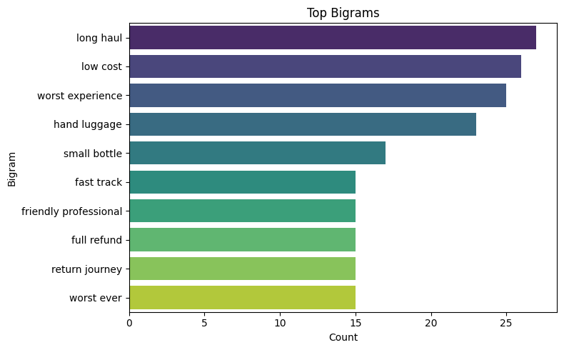
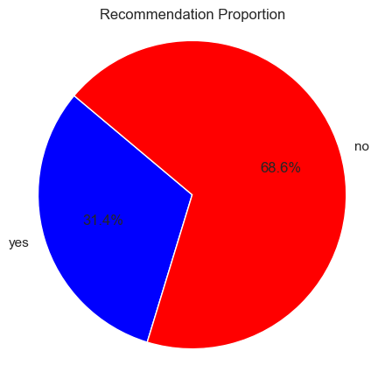
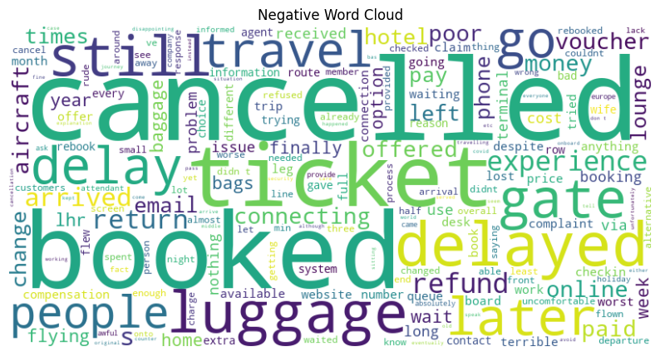
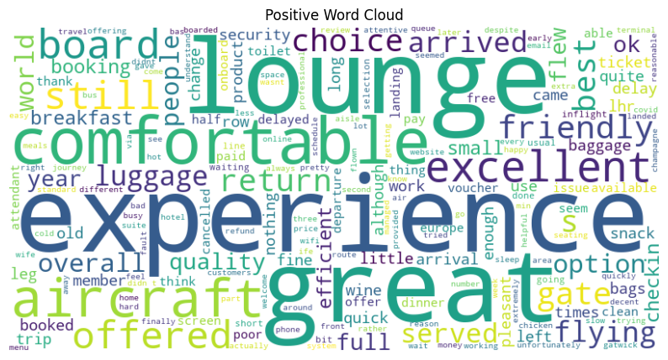
Keywords:
Great experience
Comfortable
Excellent
Friendly
Best
Cancelled
Delay
Refund
luggage

